Slide 1

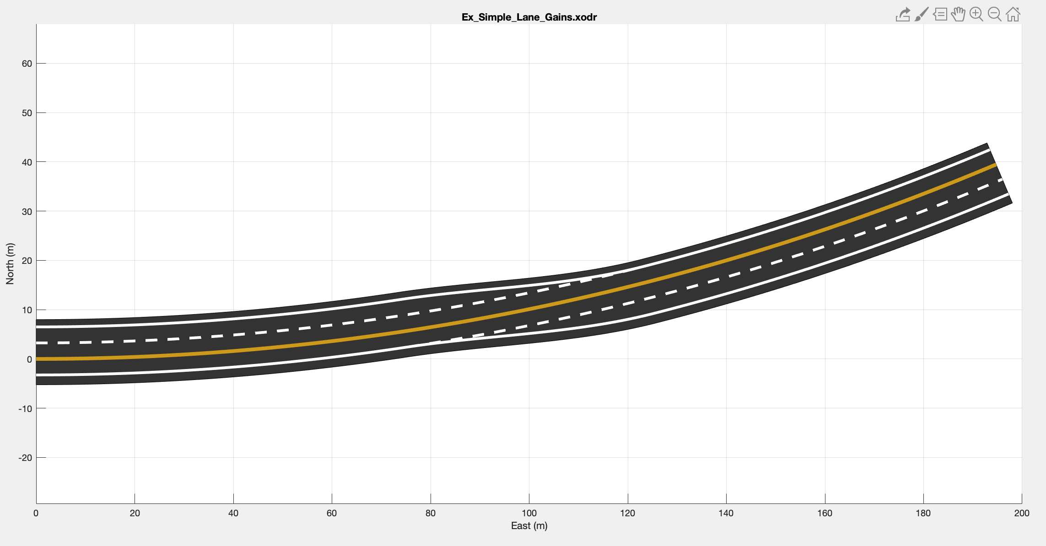
Automated Decomposition of Lane Features into ASAM OpenDRIVE
By Sean Brennan
Intelligent Vehicles and Systems Group,
Department of Mechanical Engineering，
The Pennsylvania State University
03/12/2024

Slide 2
Previously we introduced the need to define a data conversion architecture
Data storage and abstraction architecture
Mapping data conversion architecture
Raw data points
Road Grid
Road Network Map
Points associated
With traces and objects
Objects Associated with Sections
100
Speed Limit
Object Level
Objects Associated with Sections
Bridge
Speed Limit
60
Lanes Elements Geometry Representation
Lanes Graph Relationship
Lane Level
A
C
F
A
C
F
B
D
G
B
D
G
E
H
E
H
Section Level
Section Reference Lines
Section Graph Relationship
1
2
1
2
3
3
True Road

Slide 3
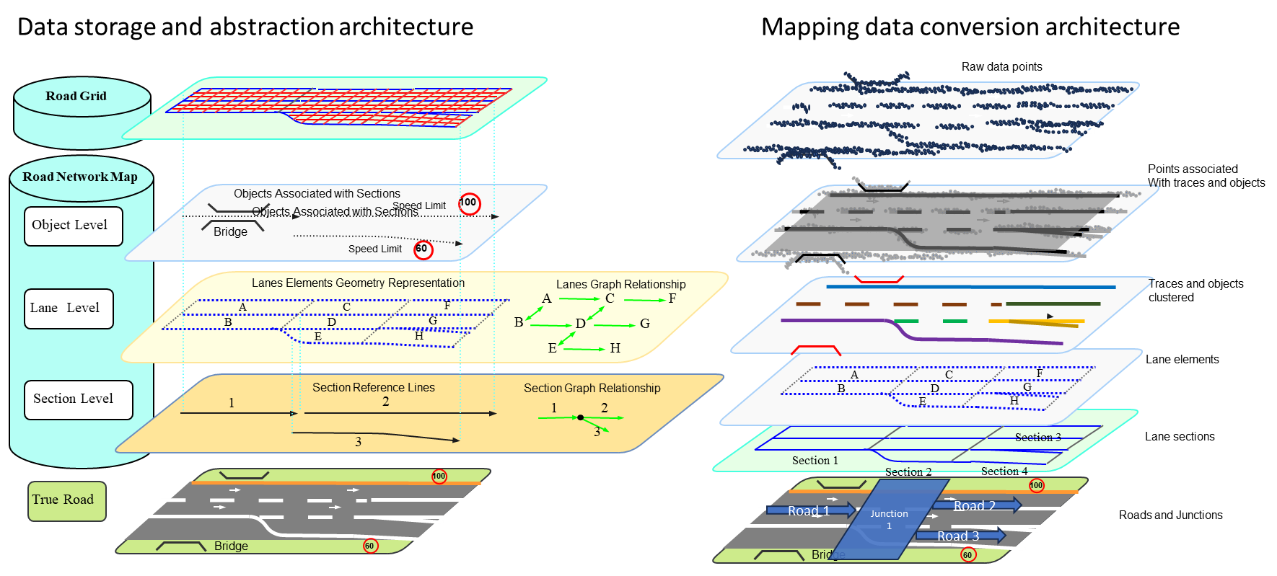

Slide 4
We specifically discussed the first 2 steps, namely grouping points into algebraically defined clusters.
Mapping data conversion architecture
Raw data points
Last Time
Points associated
With traces and objects
Traces and objects
clustered
A
C
F
Lane elements
B
D
G
E
H
Section 3
Lane sections
Section 1
Section 2
Section 4
Junction
1
100
Road 1
Road 2
Roads and Junctions
Bridge
Road 3
60

Slide 5
The purpose of this presentation is to summarize the processes used to convert algebraic objects into road definitions, namly the ASAM OpenDRIVE format
Mapping data conversion architecture
Raw data points
Last Time
Points associated
With traces and objects
Traces and objects
clustered
This presentation
A
C
F
Lane elements
B
D
G
E
H
Section 3
Lane sections
Section 1
Section 2
Section 4
Junction
1
100
Road 1
Road 2
Roads and Junctions
Bridge
Road 3
60

Slide 6

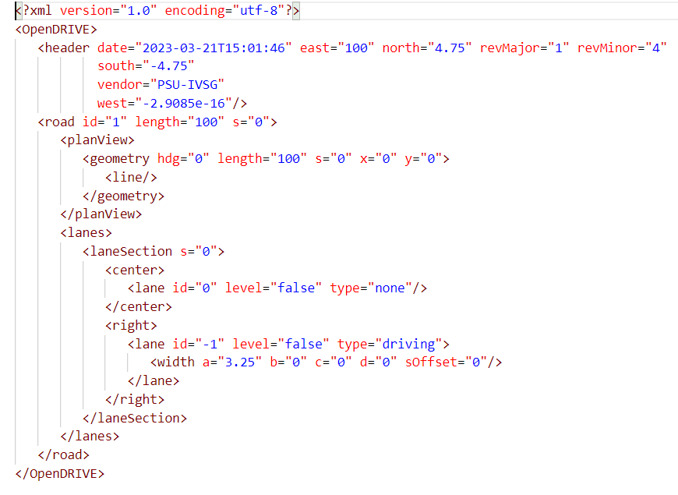
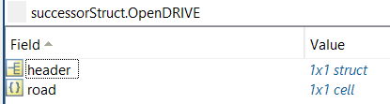
XML formats such as those used by OpenDRIVE and OpenStreetMaps mirror nested structure formats in MATLAB, allowing easy import/export.
But, you have to choose which one you want to use. Most lean toward XML directly after they get familiar with it.

Slide 7
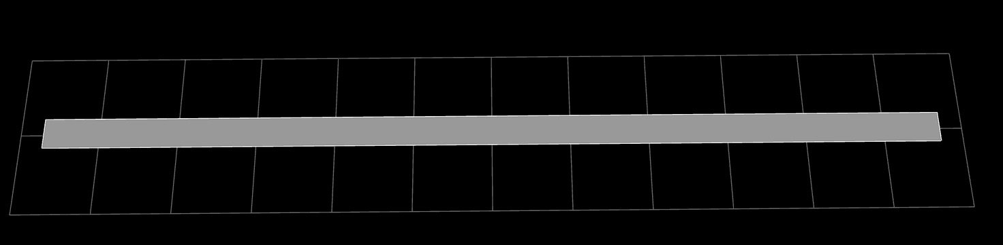
The example in the next set of slides is a one lane, one way, no shoulder straight road. It looks very boring:

Slide 8
The following slides explain how a simple road defined in a xodr file is represented in a MATLAB struct.
The example in this presentation is a one lane, one way, no shoulder straight road. See https://github.com/ivsg-psu/PathPlanning_MapTools_ParseXODR/blob/main/Data/XODRExport/XODRExport/MATLAB/01CreatedInMATLAB/testXODR_23-03-21T15-02-19_100mLine_oneLane_noShoulder.xodr
Example MATLAB struct can be found here: https://github.com/ivsg-psu/PathPlanning_MapTools_ParseXODR/tree/main/Data/MatlabStructForTestingSimpleRoads

Slide 9
The entire XODR file, wrapped by the lv1 element <OpenDRIVE>, corresponds to the (second) top-most struct in MATLAB.
Xodr content
MATLAB representation

Slide 10
The lv2 elements are <header> and <road>, where <header> is a struct, and <road> is a cell.
Xodr content
MATLAB representation

Slide 11

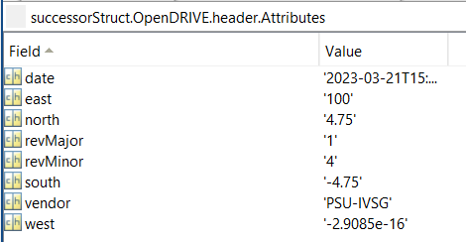
The contents in <header> are represented by a “Attributes” struct in MATLAB
Xodr content
MATLAB representation

Slide 12

Some elements are cell arrays to allow multiples (roads, lanes, etc). Here, <road> is described as cell in MATLAB, and each cell element is a struct.
Xodr content
MATLAB representation

Slide 13
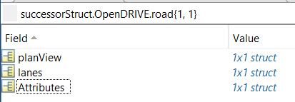
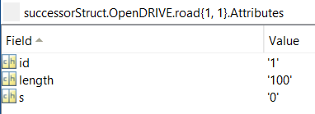
The attributes of <road>,i.e., id, length, s, are represented by a “Attributes” struct in MATLAB. All “Attributes” fields are special: in MATLAB, these are reserved to be inside the field
Xodr content
MATLAB representation

Slide 14
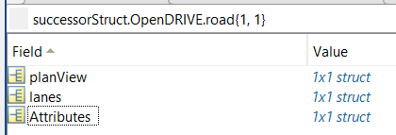
Lv3 elements under <road>, aka <planView> and <lanes>, are described as struct in MATLAB.
MATLAB representation
Xodr content

Slide 15
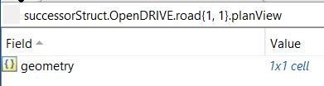

<planView> contains <geometry>, which is a cell in MATLAB. Each of the cell element is a struct.
Xodr content
MATLAB representation

Slide 16
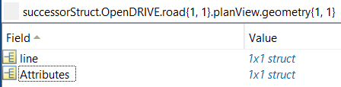
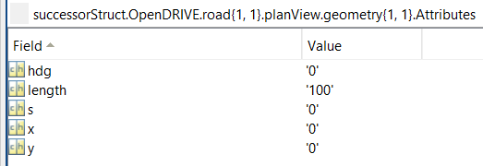
The attributes of <geometry>, aka hdg, length, s, x and y are contained in a “Attributes” struct.
Xodr content
MATLAB representation

Slide 17
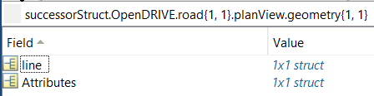
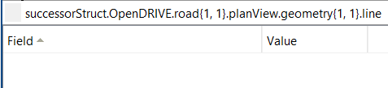
The <line> under <geometry> is an empty struct in MATLAB.
Xodr content
MATLAB representation

Slide 18
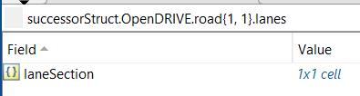
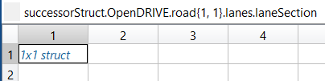
<lanes> contains <laneSection> as cell in MATLAB, and each cell element is a struct.
Xodr content
MATLAB representation

Slide 19
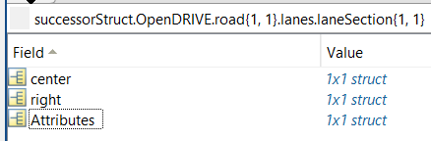
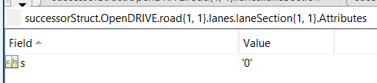
Attributes of <laneSection> are a struct “Attributes” in MATLAB.
Xodr content
MATLAB representation

Slide 20
<center> and <right> are struct in MATLAB.
Xodr content
MATLAB representation

Slide 21
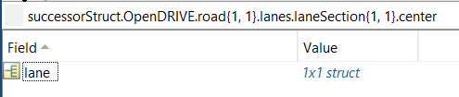
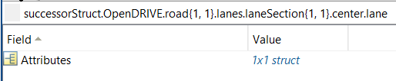
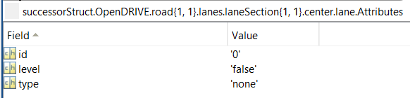
The <lane> under <center> is a struct. And the attributes of <lane> are a “Attributes” struct in MATLAB.
Xodr content
MATLAB representation

Slide 22
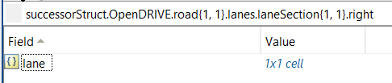

<right> is a struct in MATLAB, which contains cells. And each cell element is a struct.
MATLAB representation
Xodr content

Slide 23
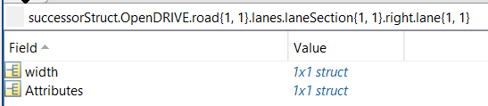
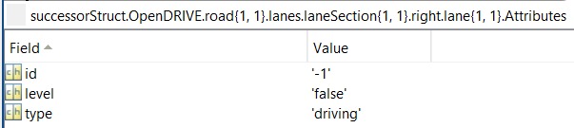
The attributes for <lane> are described as a “Attributes” struct.
MATLAB representation
Xodr content

Slide 24
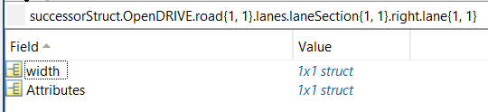
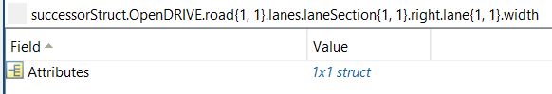
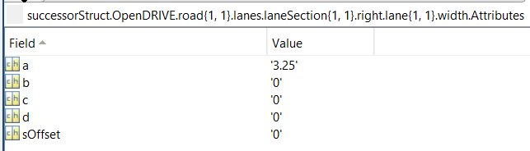
The <width> under <lane> is a struct, with attributes described as “Attributes” struct in the next level.
Xodr content
MATLAB representation

Slide 25
The previous slides show several insights:
A xodr is represented as a struct in MATLAB
A child element to its parent element, such as <header> to <OpenDRIVE>, is a child structure to this parent structure
XML fields (attributes) next to an element, such as “id” to <road>, are described as a “Attributes” structure
The “Attributes” of an element are at the same level as the children elements to this element. For example, “Attributes”, <planView> and <lanes> are all children structures to <road>
If an element can have repetitions (but different contents), they may be described as cell arrays in MATLAB. For example, <road> structures are cell arrays in MATLAB, since we may have several roads under <OpenDRIVE>. Also, <laneSection> are cell arrays in MATLAB, since we may have several lane sections under each <road

Slide 26



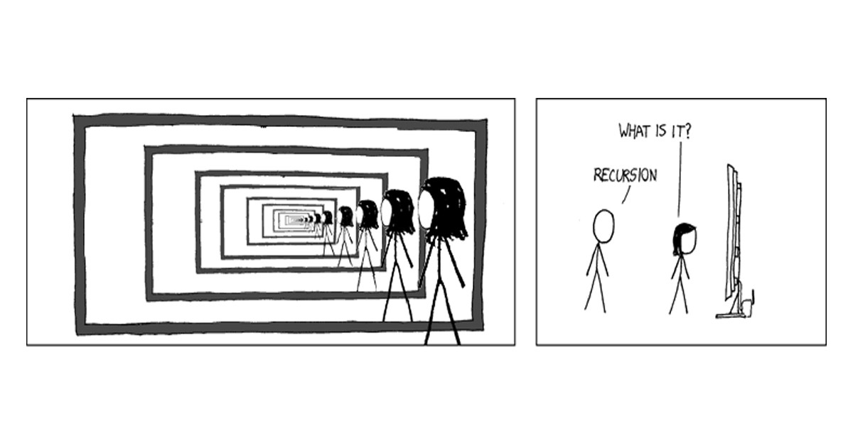
At this point, you should observe that XML within MATLAB is just a structure, in a structure, in a structure, in …

Slide 27

The mind-boggling pain of programming XML that I am swimming in now is that none of the prior students used functional recursion
Absolutely everything was hard-coded, and written from the top down

Slide 28
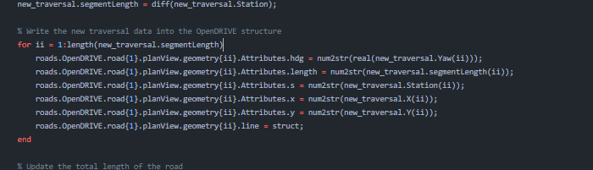
Here is an example of some horrific code
Yes, the index for geometry, road, lane sections, and lanes were ALL indexed with “ii”
Yes, it was HARD CODED
to only ever work with 1 road
Yes, thisis code operating at either 5 or 7 levels deep, across 3 different structures simultaneously

Slide 29
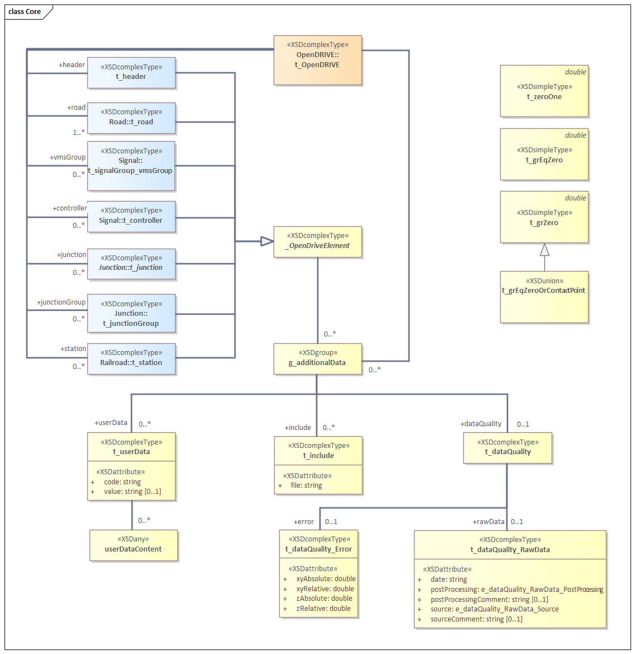
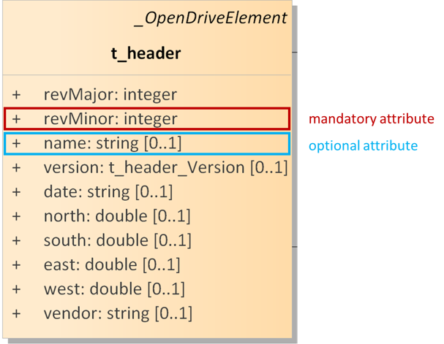
To use the XODR XML diagrams, the most important thing to learn is what’s required. Optional items have count ranges that start with 0

Slide 30
Let’s practice using the root element

Slide 31
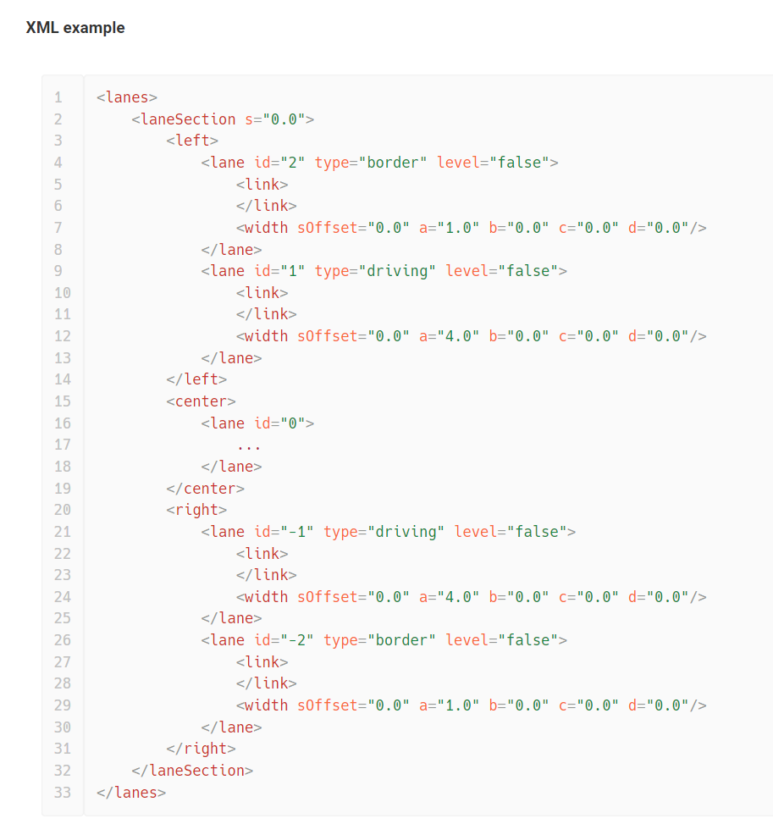
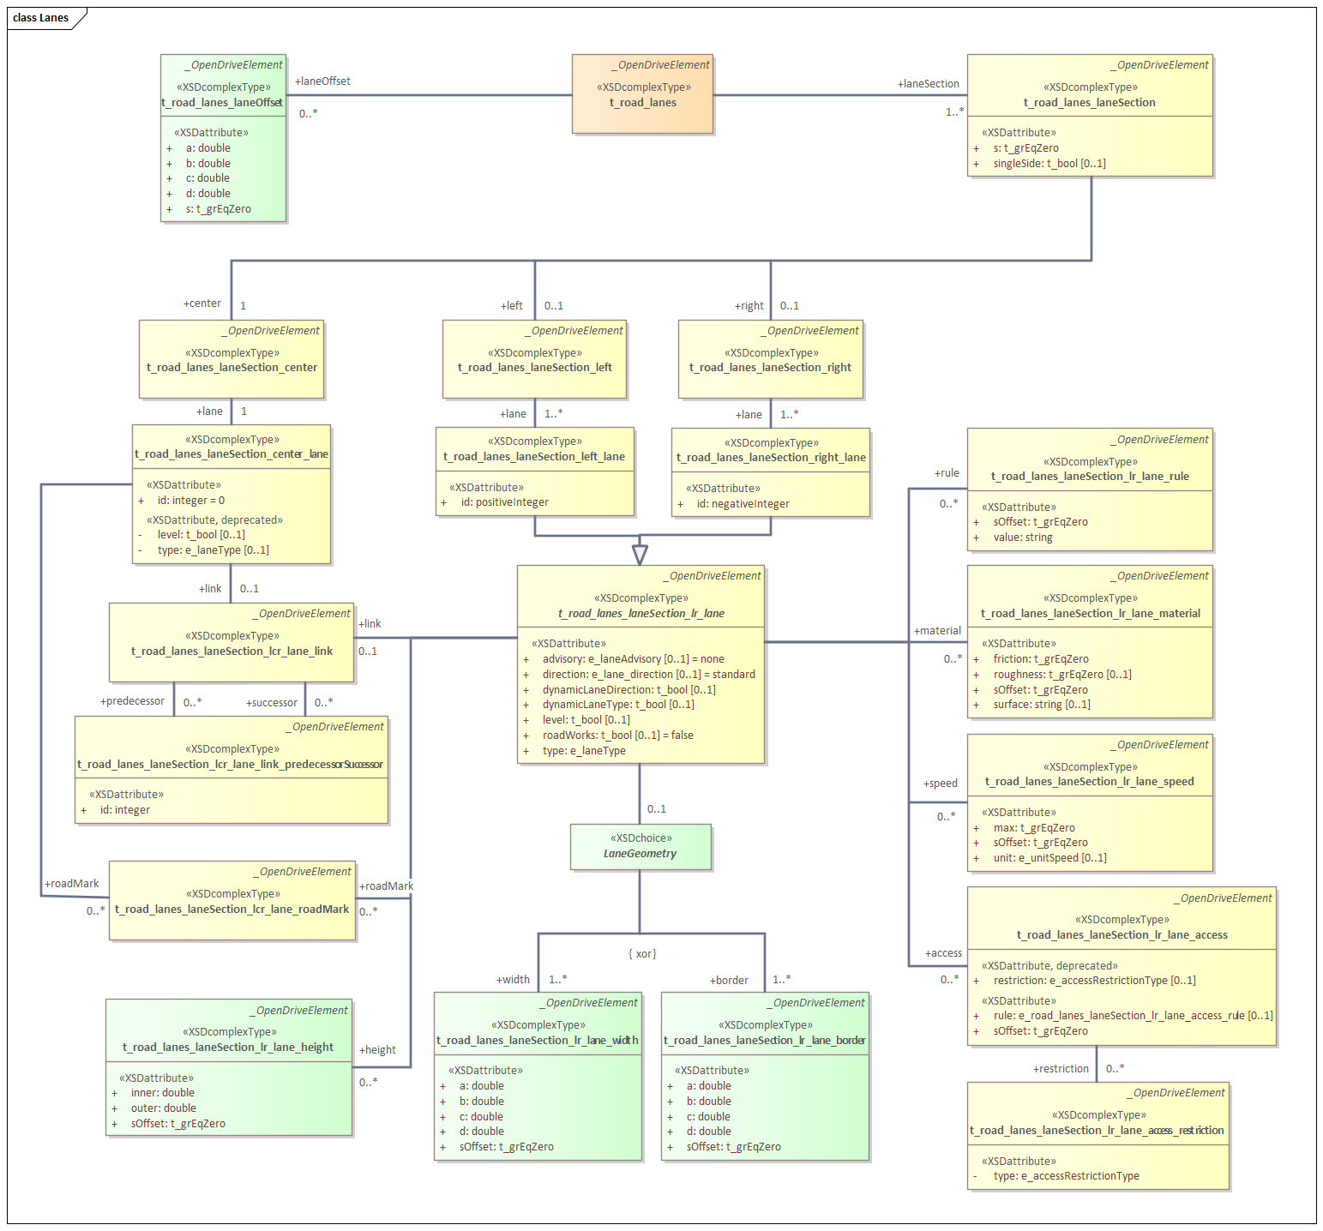
Diagrams are best understood adjacent to XML and adjacent to the resulting road image

Slide 32
In full format, OpenDRIVE XODR can be hard to read
Roads are defined in a hierarchical XML format
  OpenDRIVE enclosing element
    Header element → bounding box defined by west, east, south, north attributes
    Road elements (multiple) → define the road reference line
      Planview element (one per road)
        Geometry elements (multiple within planview element)
          Line → start point in E,N coords, start point in s coord, heading, length
          Arc → start point in E,N coords, start point in s coord, initial heading, length, curvature
          Spiral → start point in E,N coords, start point in s coord, initial heading, length, initial curvature, ending curvature
          Parametric polynomial
      Lanes
        Lane Offset elements → shift the center lane away from the road reference line
          Valid from the start station until the next lane offset element or the end of the road
          A particular implication is that a constant lane offset is needed after a non-constant element to stop the lateral change
        Lane Segment (multiple within lanes element) → break up the lanes along the s-coordinate into sections with uniform lane properties
          Left, Center, Right → for convenience, encapsulate the multiple left and right lanes in a section into grouped elements
            Lane (multiple) → define the width, type, etc. of the lanes
              Width (multiple) → cubic polynomial form defining profile in s,t coordinates
              RoadMark → gives the properties of the outer marking of the lane
      Objects
        Object elements (multiple)
          Location of object origin in S,T coords
          Bounding box (length, width or radius of circle in u,v coords)
          Outline element (optional)
            Corners in S,T coords or local u,v coords
          Repeat element to repeat objects with linearly varying parameters
NOTE: OpenDRIVE 2.0 is in development, and may break almost everything that depends on these definitions!!!

Slide 33

There exist several xml2struct tools that can convert the XML into a MATLAB structure that preserves the hierarchy of the OpenDRIVE road structure.
% Load an example file from a static file path
ODRStruct = fcn_ParseXODR_convertXODRtoMATLABStruct('Ex_Simple_Lane_Offset.xodr');
% Convert and save the OpenDRIVE structure to an .xodr file with the specified output file name
fcn_ParseXODR_convertODRstructToXODRFile(ODRStruct, full_filename, fig_num);

Slide 34
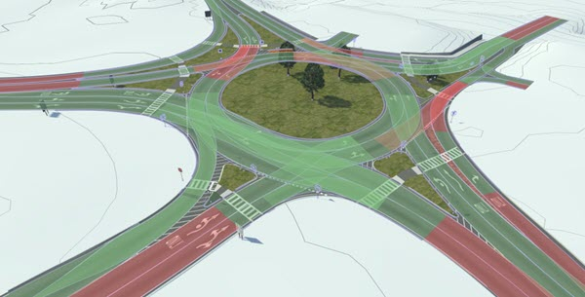
The structure to XML file duality is not perfect
Fields names match
Multiple fields (e.g. roads, geometry elements of a road, objects) are listed in structure arrays, which make sense
All data values at the lowest level “leaves” of the “tree” are represented in strings and must be converted with str2num() or str2double() for calculations in MATLAB
Every element has a separate “Attributes” structure rather than including the attributes in the element itself, leading to “deeper” addressing of the actual data

Slide 35
To this point, we have covered the following topics
XML to Struct similarities
Some of the hierarchies
Glitches
Next, we’ll cover detailed input/output codes and toolsets
Mapping data conversion architecture
Raw data points
Last Time
Points associated
With traces and objects
Traces and objects
clustered
This presentation
A
C
F
Lane elements
B
D
G
E
H
Section 3
Lane sections
Section 1
Section 2
Section 4
Junction
1
100
Road 1
Road 2
Roads and Junctions
Bridge
Road 3
60

Slide 36
Good parts of OpenDRIVE structure in MATLAB
Cell arrays are used anywhere multiple elements exist at a level
  Easy to iterate over the cell arrays (though requires loops)
Easy to compute (X,Y) coords from (S,T) representation
Each segment has initial pose (x0,y0), h0 and s0 plus the geometry descriptors and can thus be loaded/plotted separately from the others
Objects can be “indexed” by station to determine which segment to compute the geometry from
  The initial pose of the segment allows for “local” computations using the segment initial values rather than referencing the road start

Slide 37
Bad parts of OpenDRIVE structure in MATLAB
The xml2struct function produces inconsistent structure hierarchies when layers contain only a single element
  Cell arrays of structures for multiples, structure for singles
  Can fix this easily, but has to be done at many different locations in the XODR structure tree
  Addressed by fcn_RoadSeg_convertXODRtoMATLABStruct
Reliant on proper XODR formatting to ensure segment ordering is correct (in order of increasing station)
  Addressed by fcn_RoadSeg_XODRSegmentChecks
Malformed segments or inconsistencies in XODR will transfer through to the MATLAB structure
  May need to have a MATLAB routine to check that (xF,yF) as well as hF at sF matches with (x0,y0) as well as h0 at s0 of the next segment
  Addressed by fcn_RoadSeg_XODRSegmentChecks
Need a separate lookup table to correlate objects with the road geometry segment they are located with respect to
Lanes are defined section-by-section and can “shift” identifier from one section to the next if a lane appears (begins with zero width and widens) or disappears (narrows to zero width) at the lane section boundary
Objects do not have any built-in attributes for appearance (e.g. color)
  Can be stored in <userData> within the object elements

Slide 38
MATLAB Toolsets for OpenDRIVE Parsing/Plotting

Slide 39
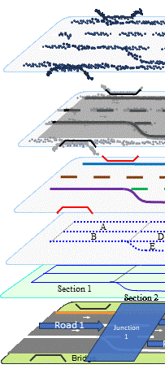
The toolsets to create the XODR file follow from the structure of the XML
ParseXODR repo -
extractXYfromSTandGeometries
extractXYFromSTCurves
extractXYfromSTArc
extractXYfromSTSpiral
Raw data points
PathClass repo -
createStFromXYPoints
Points
Geometry repo -
comparePointsToPoints
Points associated
With traces and objects
Curves
ParseXODR repo -
extractCurvesFromLaneEdges
Geometry repo -
comparePointsToCurve
compareCurves
Geometry repo -
fitSequentialArcs
Lane Edges
Traces and objects
clustered
ParseXODR repo –
createRoadCenterlineFromCurves
createLaneEdgesFromCurves
createLaneIDs
createLanesFromEdges
createLaneConnectivity
ParseXODR repo -
extractLaneEdgesFromLanes
ParseXODR repo -
compareLaneEdges
Lane
A
C
F
Lane elements
ParseXODR repo -
compareLanes
compareLaneSegments
LaneSections
B
D
G
ParseXODR repo -
extractFromLanes_LaneOffsetStations
extractFromLanes_LaneSectionStations
extractFromLanes_tCenterLane
extractFromLanes_LaneLinkages
ParseXODR repo -
createLaneSectionsFromLanes
E
H
Lanes
Section 3
Lane sections
Section 1
Section 2
Section 4
Junction
1
100
ParseXODR repo –
extractLaneSectionsFromRoads
extractFromRoad_LengthAndID
extractFromRoad_LanesSt
extractFromRoadPlanView_STtoXY
extractFromRoadPlanViewRdSegStations
extractFromOpenDRIVE_Roads
fcn_ParseXODR_plotXODRinENU
Roads
ParseXODR repo -
compareRoads
ParseXODR repo -
createRoadsFromLaneSections
Road 1
Road 2
Roads and Junctions
Bridge
Road 3
60
XODR
fcn_ParseXODR_plotXODRinENU

Slide 40
The first step is to understand the curve representations
ParseXODR repo -
extractXYfromSTandCenterline
extractXYfromSTandGeometries
extractXYFromSTCurves
extractXYfromSTArc
extractXYfromSTSpiral
Raw data points
Points
Points associated
With traces and objects
Curves

Slide 41
Every road has a centerline. The function extractXYfromSTandCenterline uses the centerline and user-given St coordinates to find local XY coordinates
XY points for 1 column
of transverse data
XY points for 2 columns
of transverse data
Original Road
Centerline

Slide 42
The centerline geometries for each scenario are as follows
Scenario | Outer lane center of double yellow | New lane 1, left side center | New lane 2, left side center | New lane 3, left side center | Detour lanes
1.1 – Work on Shoulder | X
1.2 – Standard Detour |  |  |  |  | X
1.3 – Lane shift into opposing |  | X
1.4 - Lane shift into turn lane |  | X
1.5 – Work in center turn lane |  | X
1.6 – 3 lane highway, work in right lane |  |  |  | X
2.1 – State highway detour |  |  |  |  | X
2.2 – Self-regulating start/stop 1-lane |  | X
2.3 – Lane shift to temp roadway |  | X (custom)
2.4 – Start/stop 1-lane with signal |  | X
3.1 – Moving work on shoulder | X
4.1a – Highway work in right lane |  |  |  | X
4.1b – Highway work in right lane - tnpk |  |  |  | X
4.2 – Highway exit ramp |  |  |  | X
4.3 – Highway entrance ramp |  |  |  | X
5.1a – Moving right lane highway |  |  |  | X
5.1b – Moving right lane - turnpike |  |  |  | X
5.2 – Moving left lane |  |  |  | X
6.1 – 2-lane long-term 2lane shoulder |  |  |  | X

Slide 43
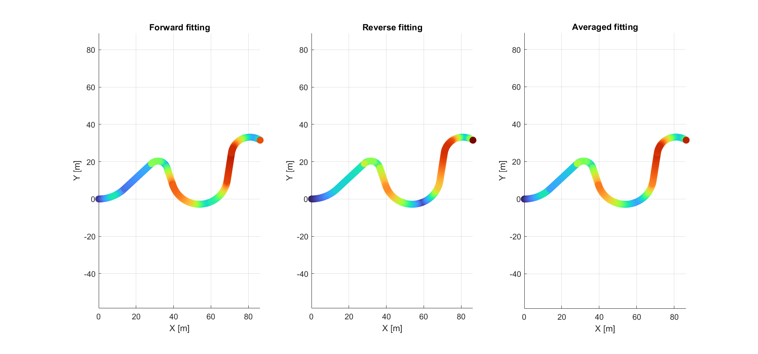
To fit the roads, we have automated methods to fit raw data to arcs, lines, etc. and as well check the quality of the fits (red is 10 cm error, blue is 0)

Slide 44
For the outer lane centerline

Slide 45
The call stack to obtain XY points from St curves follows the XODR structure
fcn_ParseXODR_ extractXYfromSTandCenterline
(for each geometric section)
fcn_ParseXODR_extractXYfromSTandGeometries
(for each curve type)
fcn_ParseXODR_extractXYfromSTCurves
(specifically for arcs or spirals)
fcn_ParseXODR_extractXYfromSTArc
fcn_ParseXODR_extractXYfromSTSpiral

Slide 46
When exporting the lane segments from the road, the connection between the lanes must be determined
For each lane section, and separate for left and right lanes
  Initialize row in matrix with NaNs at same width as previous row
    First row gets initialized to the number of lanes in first lane section
  Iterate through each lane in the lane section
    First lane section simply gets column values by self-ID of each lane
    Get the predecessor ID of the current lane
    Check to see if the predecessor ID exists
      If exists:
        place lane in matrix by looking up the column index of the predecessor lane ID in the previous row of the matrix
      If does not exist:
        append a column of NaNs to the lane matrix
        place the current lane ID in the last row/column space

Slide 47
Example lane linkages are shown below
LaneLinksLeft:
1 2 3
1 2 3
1 NaN 2
LaneLinksRight:
1 2 NaN
1 3 2
1 3 2

Slide 48
Example lane linkages are shown below
LaneLinksLeft:
1 2 NaN
1 2 NaN
1 NaN NaN
1 NaN 2
1 NaN 2
LaneLinksRight:
1 2
1 2
1 2
1 2
1 2

Slide 49
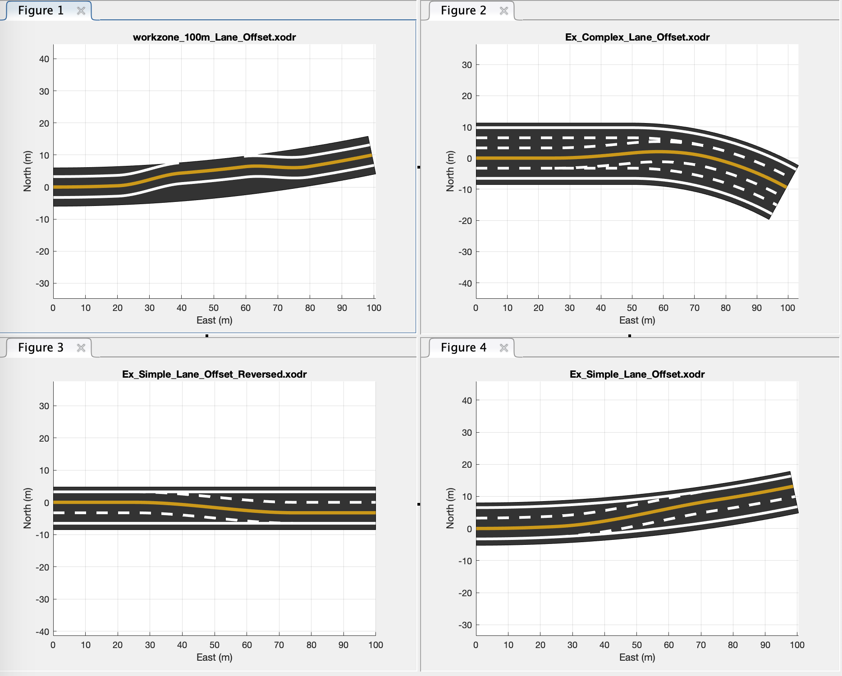

Slide 51
Key Functionalities needed for MATLAB → XODR
Construction of XODR files given a particular MATLAB struct
  Manual scripted construction of XODR MATLAB struct
  Interactive construction of XODR MATLAB struct
  Checking an XODR MATLAB struct for construction consistent with OpenDRIVE spec
  Writing an XODR MATLAB struct to an OpenDRIVE XODR file
Conversion of recorded data to OpenDRIVE XODR files
  Fitting of road reference line segments (line, arc, spiral) from data
  Conversion of reference line segments into XODR MATLAB struct
  Fitting of lane widths relative to center lane
  (assuming no lane offsets between reference line and center lane in data)
  Classification of lane sections with uniform lane properties and writing to XODR MATLAB struct
  Determination of bounding boxes (rectangular or cylindrical) and optionally vertices of objects
  Coordinate transformation into road coordinates and writing to XODR MATLAB struct
  Checking an XODR MATLAB struct for construction consistent with OpenDRIVE spec
  Writing an XODR MATLAB struct to an OpenDRIVE XODR file

Slide 52
Construction of XODR MATLAB Structures (Complete)
script_RoadSeg_defineXODRStructManual - a script that demonstrates how to build the XODR MATLAB structure from scratch primarily using simple MATLAB syntax
  Uses fcn_RoadSeg_findXYfromST to determine the end position and heading of one road geometry element in order to propagate as the start position and heading of the next element
  Uses fcn_RoadSeg_XODRSegmentChecks to ensure that the manually-created structure is compliant with the OpenDRIVE standard
  Uses fcn_RoadSeg_plotRealisticRoad to create a graphical representation of the road with realistic colors and accurate shape in (E,N) coordinates
  Uses fcn_RoadSeg_extractXODRSegments to find the boundaries of the various geometry elements, lane offsets, and lane sections of the road for plotting purposes.
  Uses fcn_RoadSeg_findXYfromSTandODRRoad to convert the section boundaries into X,Y positions that can be plotted over the roadway
  Uses struct2xml (59411 from Mathworks File Exchange) to write the structure into XML/XODR format.

Slide 53
Construction of XODR MATLAB Structures (Complete)
script_RoadSeg_defineXODRStructPrompted - a script that aids a user in building the XODR MATLAB structure through a series of text and graphical prompts
  Uses fcn_RoadSeg_findXYfromST to determine the end position and heading of one road geometry element in order to propagate as the start position and heading of the next element
  Uses fcn_RoadSeg_XODRSegmentChecks to ensure that the manually-created structure is compliant with the OpenDRIVE standard
  Uses fcn_RoadSeg_plotRealisticRoad to create a graphical representation of the road with realistic colors and accurate shape in (E,N) coordinates
  Uses fcn_RoadSeg_extractXODRSegments to find the boundaries of the various geometry elements, lane offsets, and lane sections of the road for plotting purposes.
  Uses fcn_RoadSeg_findXYfromSTandODRRoad to convert the section boundaries into X,Y positions that can be plotted over the roadway

Slide 54
Construction of XODR files

Slide 55
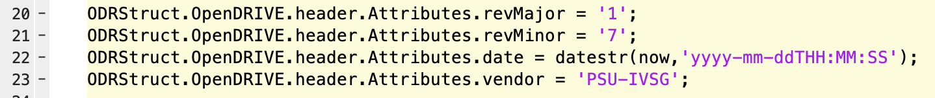
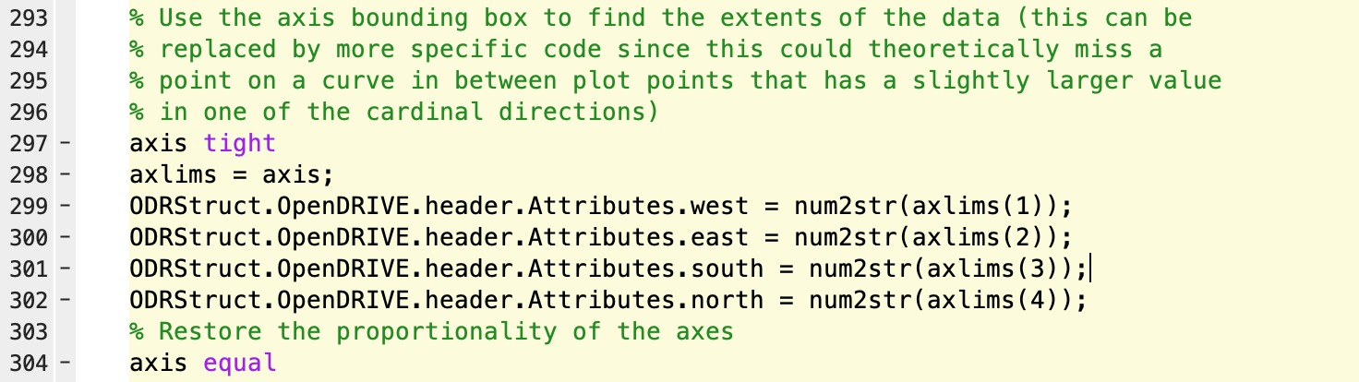
Filling the header

Slide 56
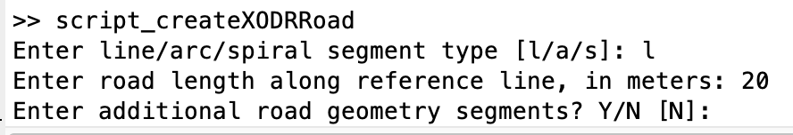
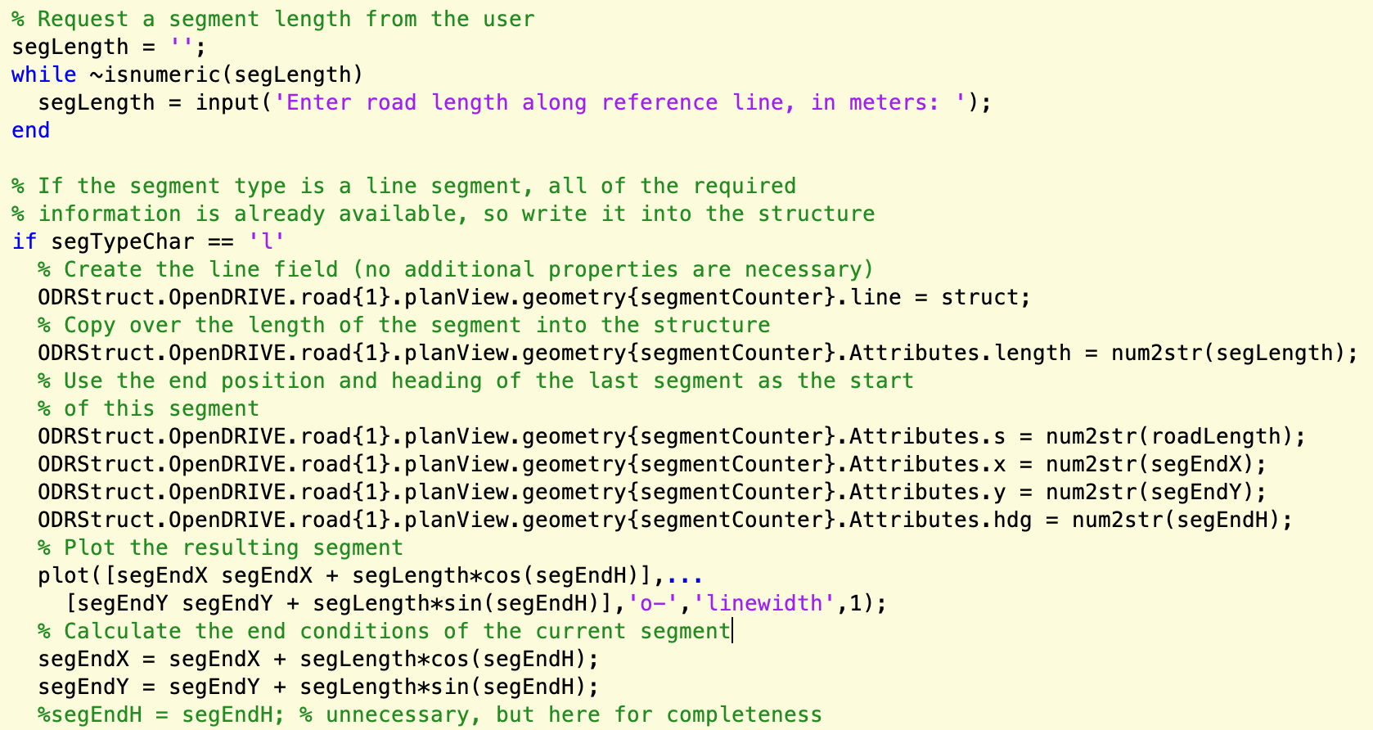
Describing the path (line)

Slide 57
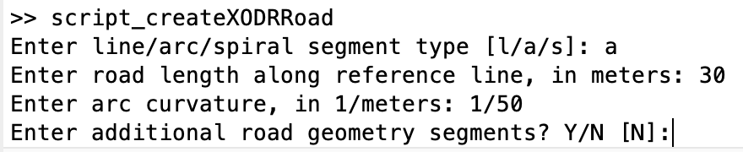
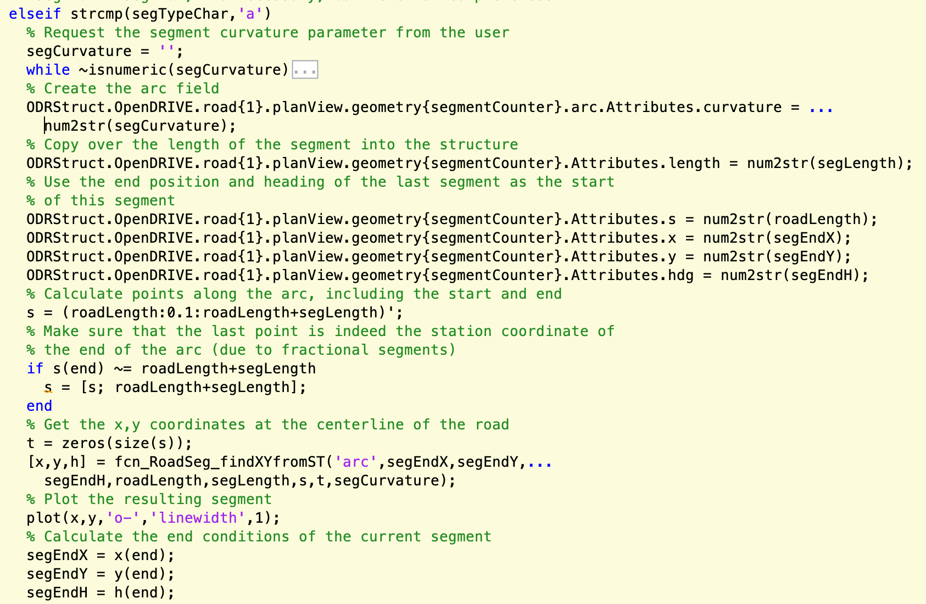
Describing the path (arc)

Slide 58
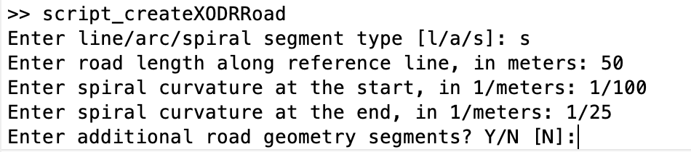
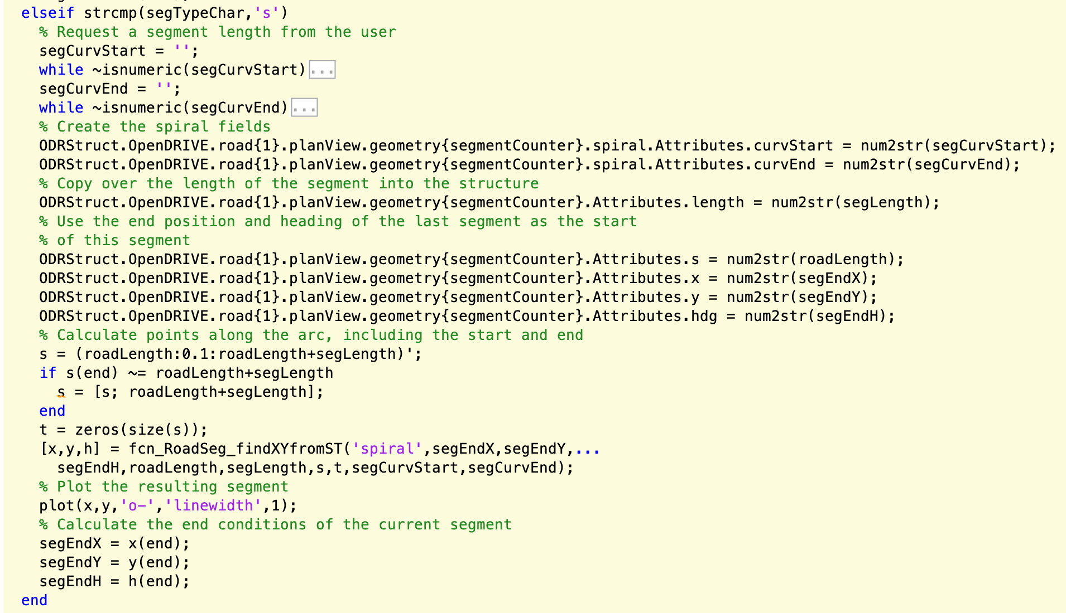
Describing the path (spiral)

Slide 59
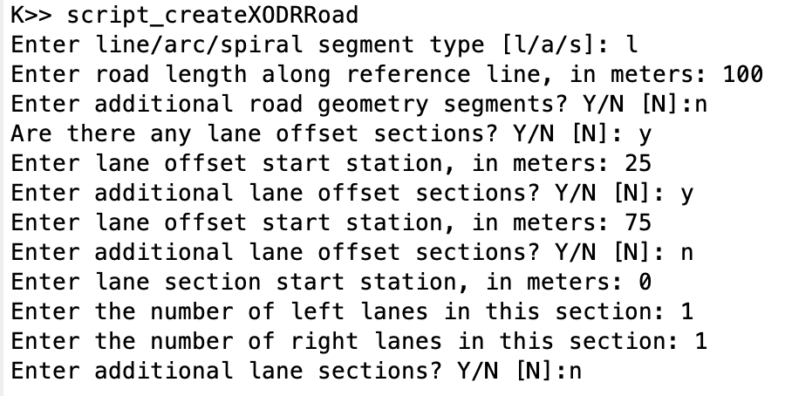
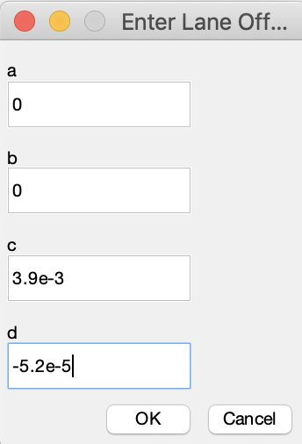
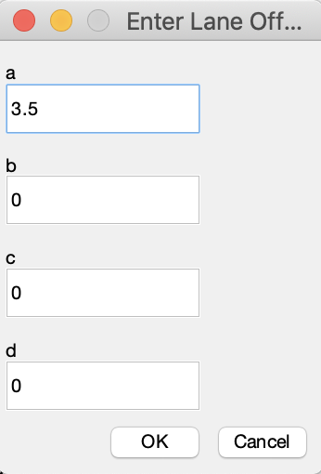
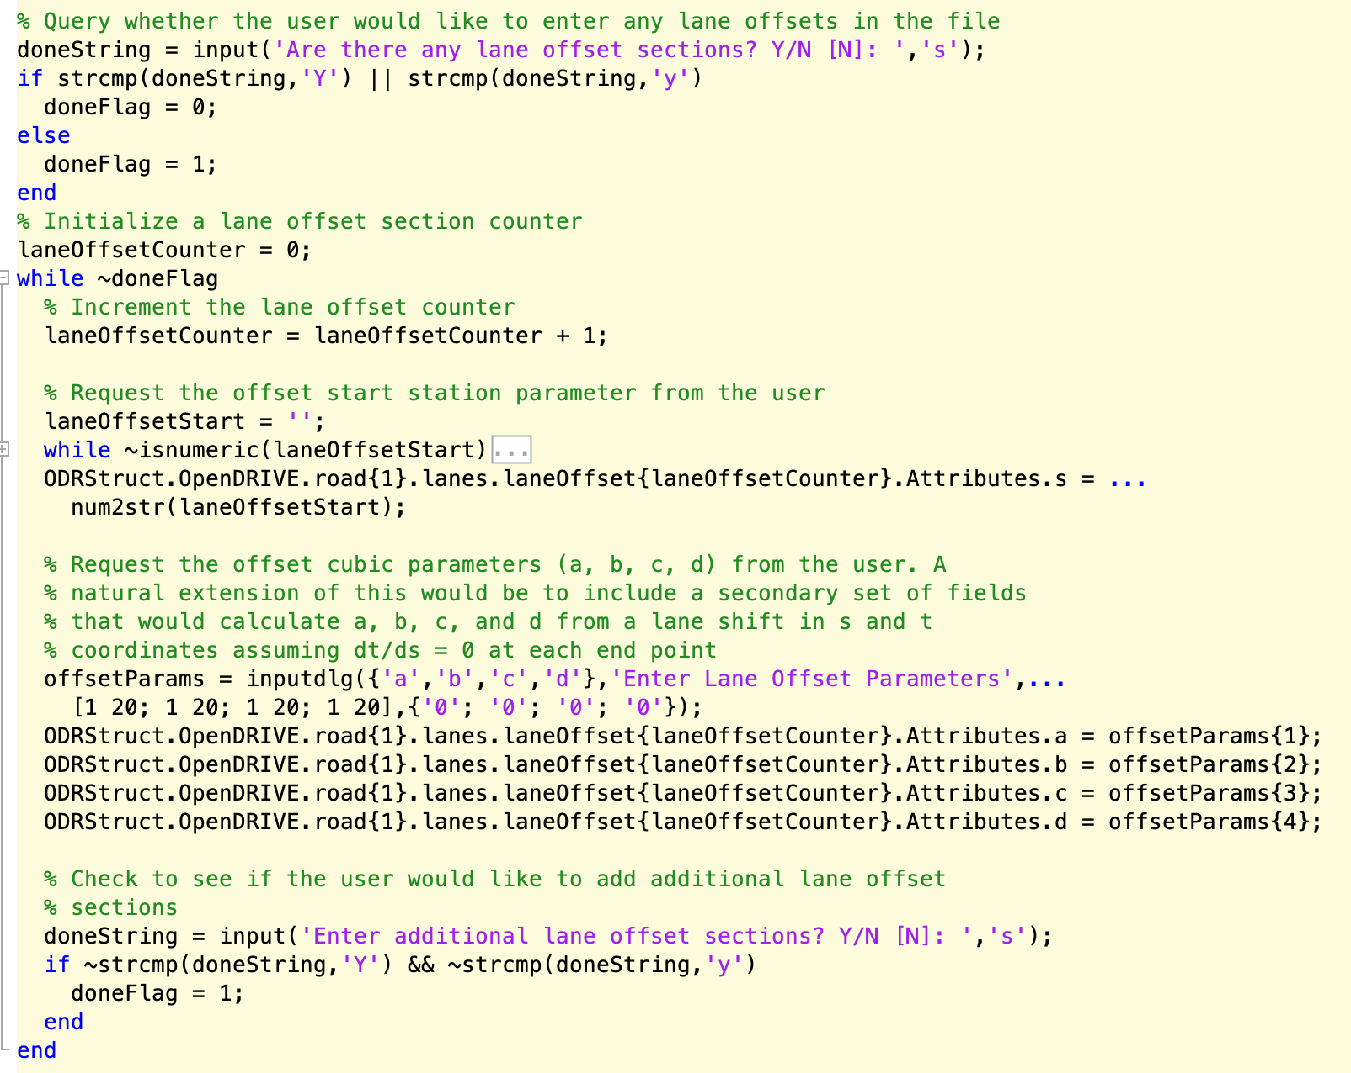
Setting lane offsets

Slide 60
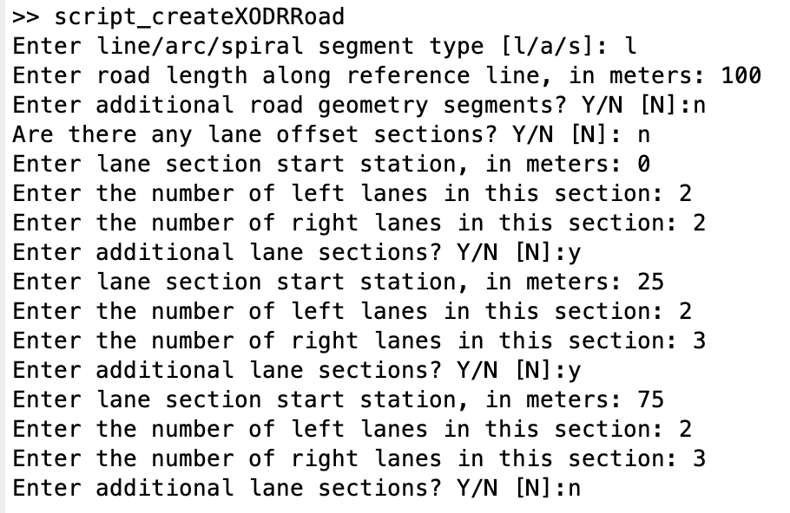




Setting lane sections

Slide 61
Lane Linkage
Need to determine which lanes “appear” or “vanish” as
the sections progress in order of increasing station. In the
example below, two right lanes in the first lane section
become three right lanes in the second. The first lane
(closest to the center) continues, as does the third lane
(the shoulder), so lane 2 in the second section is the
“appearing” lane. This means is has no predecessor.
Similarly, lanes can disappear, in which case they simply
have no lane that refers to it as a predecessor. The MATLAB
code does not use successor elements, but they can be
included for completeness. A table of the links for the
example is provided below. These are entered into the
structure or XODR file manually.
None | None | None | None | None | None
-3 | None | -1 | 0 | 1 | 2
-3 | -2 | -1 | 0 | 1 | 2

Slide 62
Conversion of data into XODR Structures (Incomplete)
No top-level script or function yet exists for this purpose
script_RoadSeg_defineXODRStructManual provides a blueprint for how to create the XODR structure in MATLAB.
  Some of the XODR elements will need to be defined manually, as in this script.
  Other XODR elements will come from functions yet to be written.
Data-fitting code is needed that can convert paths (or traversals) into segments with uniform curvature properties for planView representation of the road
  Line -> zero curvature from start to end station
  Arc -> constant but non-zero curvature from start to end station
  (positive for left curves, negative for right curves)
  Spiral -> linearly changing curvature from start to end station
  (positive for left curves, negative for right curves)
  Other curves are possible, but not implemented
Other data fitting is needed to determine sectioning and cubic polynomial fits for road grade, lane offsets (could be zeroed by definition), and lane widths relative to center lane.

Slide 63
Key Functionalities for XODR → MATLAB
Loading an OpenDRIVE XODR file into a MATLAB XODR structure
  Checking resulting MATLAB XODR struct for inconsistencies with OpenDRIVE standard
Converting objects from XODR structures into PSU patch format
  Creation of point clouds (outlines) to represent objects in (E,N) space
  Conversion of cornerRoad or cornerLocal definitions into (E,N) space
  Conversion of (E,N) point clouds into PSU patch format for analysis/plotting
Converting road geometry information into PSU path traversals format
  Creation of (E,N) point sequences to represent road centerlines in (E,N) space
  Creation of (s,t) point sequences to represent continuous lane boundaries along the road path
  Conversion of (s,t) point sequences into (E,N) space
  Conversion of (E,N) point sequences into traversals
Plotting road/lane geometries and objects from XODR structures

Slide 64
Coordinate Conversion Functions (Complete)
fcn_RoadSeg_findXYfromSTandODRRoad – top-level conversion function, accepts vectors of (s,t) coordinates and a structure of one road element from the OpenDRIVE structure. Wrapper for fcn_RoadSeg_findXYfromSTandSegment.
fcn_RoadSeg_findXYfromSTandSegment – second-level conversion function, accepts vectors of (s,t) coordinates and a geometry element from the OpenDRIVE structure. Wrapper for fcn_RoadSeg_findXYfromST.
fcn_RoadSeg_findXYfromST – third-level conversion function, accepts vectors of (s,t) coordinates as well as all of the geometric parameters of a road segment in order to calculate the (X,Y) coordinates. Wrapper for fcn_RoadSeg_findXYfromXODRArc and fcn_RoadSeg_findXYfromXODRSpiral as well as handles calculations for lines internally.
fcn_RoadSeg_findXYfromXODRArc – conversion function that accepts a vector of station coordinates (no lateral offsets) and the parameters of an arc and returns the (X,Y) position of the points along the arc
fcn_RoadSeg_findXYfromXODRSpiral – conversion function that accepts a vector of station coordinates (no lateral offsets) and the parameters of an spiral and returns the (X,Y) position of the points along the spiral

Slide 65
Loading OpenDRIVE XODR files into MATLAB (Complete)
fcn_RoadSeg_convertXODRtoMATLABStruct – reads an OpenDRIVE XODR file and creates a MATLAB XODR structure suitable for use in analysis and plotting
  Uses xml2struct_fex28518 to do the basic read of the XML file into a MATLAB structure, but leaves some inconsistencies in the structure, specifically when there are single elements in the structure where there can be multiple elements, depending on the road/lane geometries
  The next step of the function converts singleton structure elements into single-element cell arrays for consistency of elements for which there can be multiple elements
  The last step of the function handles expanding repeated objects into individual elements in the cell array.
  The function returns a single structure representing the entire road system defined in the OpenDRIVE XODR file.

Slide 66
Loading OpenDRIVE objects into MATLAB (Complete)
fcn_RoadSeg_convertXODRObjectsToPatchObjects – pulls objects out of the XODR MATLAB structure and inserts them into a patch array
  The first step of the function creates a segment table that identifies the types and start/end stations of each geometry element for locating objects in (E,N) coordinates relative to the road.
  The biggest portion of the function iterates through each of the objects, filling out the parameters
    Color is set to blaze orange for all
    An ID is created for each object
    The geometry of the object is represented with a point cloud created to represent the outline. If “corners” (there may be many) of the object are provided, these are converted to XY points. If only a bounding geometry is provided, points are created along the bounds to form an outline of the object.
  (All geometries of the objects are converted to (E,N) coordinates by calling fcn_RoadSeg_findXYfromSTandSegment after cross referencing the (s,t) coordinates of the object with the segment table created at the start.)

Slide 67
Converting OpenDRIVE roads into MATLAB (Complete)
Since roads have multiple aspects of their geometry (reference line, lane offsets, lane widths, etc.) there is no individual function to convert an entire road into MATLAB. Instead, a series of functions pull out the individual geometries.
fcn_RoadSeg_findXYfromSTandODRRoad – converts the road geometry defined in (s,t) coordinates and segments into (E,N) coordinates. By providing a vector of station coordinates ranging from 0 to the end of the road and a t-coordinate vector of all zeros, this function returns the reference line of the road.
fcn_ParseXODR_extractLaneGeometry – extracts the lane borders from the XODR structure, outputting matrices of (s,t) coordinates for each of the left, center, and right lanes. The function fcn_RoadSeg_findXYfromSTandODRRoad can then be used to convert again to (E,N) coordinates.
fcn_Path_convertPathToTraversalStructure – not part of the XODR/MATLAB library, but can be used to convert reference lines and lane borders into PSU path library traversal structures

Slide 68
Plotting OpenDRIVE roads in MATLAB (Complete)
fcn_RoadSeg_plotRealisticRoad – uses the XODR MATLAB structure to plot a quasi-realistic view of the road geometry
  Accepts a complete XODR MATLAB structure and creates the plot, returning a handle to the plot figure window
  Assumes:
    the center lane should be marked with double yellow
    the extreme outer lane is the shoulder and the bounding line is the outer road (shoulder) edge
    the boundary of the lane just to the inside of the shoulder defines the driving boundary of the road and should be marked with a solid white line
    all lanes between the driving boundary and the center lane should be marked with dashed white lines
  Uses fcn_ParseXODR_extractLaneGeometry to pull out the lane boundaries in (s,t) coordinates
  Uses fcn_RoadSeg_findXYfromSTandODRRoad to convert the lane boundaries into (E,N) coordinates
  The remainder of the function code creates the individual plotting elements.
  Note: Before plotting any lane lines, the road surface is plotted with a MATLAB patch using the identified left and right extents of the road found from the extremes of the lane boundaries. This requires the lanes to be extracted from each of the road elements in sequence. The lane markings are then extracted a second time and plotted over the top of all of the road surface elements. This approach is not computationally efficient, but solves the problem of having road surface plotted on top of previously plotted lane markings and is simpler than keeping all of the lane boundaries in memory for plotting lane markers after previously reading them in to plot the road surface.

Slide 69
Project management notes

Slide 70
Next steps
There are numerous aspects of OpenDRIVE that are not currently included in the code. Some of these should probably be implemented:
  Cubic polynomial road geometry (deprecated) or parametric polynomial geometry
  Road markings -> reading from a file and plotting (harder) as well as writing (easy in manual construction)
  Lane border elements (different than widths)
  Road linkages and junctions
    Plotting center lines with specified road markings will help with better realism in junctions
Function fcn_RoadSeg_XODRSegmentChecks is a bit limited. There are numerous additional checks that can (should?) be added or modified:
  Lane linkage checks (predecessor tags present for all but first lane section)
  Lane offset continuity check
  Lane width continuity check
  Degenerate object vertices (cornerLocal or cornerRoad) check
  Ability to include lane widths in the bounding box check (this is technically a bug)
Testing, testing, testing!
  No formalized testing of this code has been done.

Slide 71
The example files used in this document can be found at https://github.com/ivsg-psu/PathPlanning_MapTools_ParseXODR/blob/main/Data/XODRExport/XODRExport/RR/02ExportedFromScene/RR_Junction_highwayPassing.xodr
For a complete explanation of lane properties, please see https://www.asam.net/index.php?eID=dumpFile&t=f&f=3495&token=56b15ffd9dfe23ad8f759523c806fc1f1a90a0e8#_lane_properties
Open source xodr viewer can be found at: https://odrviewer.io/

Slide 72

Why we need clear definitions of lane properties? Because this is required to generate HD maps from mapping data in an automatic way!

Slide 73

This document explains the properties to describe a lane based on ASAM OpenDrive 1.6. A simple example of an intersection formed by two straight roads is used.

Slide 74


Lane 1 of road 0 is used as an example to explain the lane properties.
Definition in xodr
Visual in xodr viewer

Slide 75
Step 1. Lane offset is described.

Slide 76

The attributes of lane offset are described below.
The lanes are constructed as polynomials, usually. This is NOT how the mapping process is done, so we use fitting tools to convert actual field datapoints into polynomials.

Slide 77


An example of lane offset is below. A lane offset is added at s = 75.
Original lane
Modified lane

Slide 78
Step 2. Lane section is described.

Slide 79

The attributes of lane section are below.
Lanes can be difficult to describe within construction zones, and lane ambiguity is likely to be the largest challenge for AVs

Slide 80


The effect of “singleSide” attribute is not able to visualize. However, it may affect the traffic rule applying to vehicles.

Slide 81
Step 3. Whether this lane is left, center, or right is described.

Slide 82

Changing the <left> to <right> breaks the file, since a <right> element already exists, and this causes a conflict.
Bird view of the original road
Bird view when changing <left> to <right> in road 0. The road is broken.

Slide 83
Step 4. Lane ID, type and level are described. Here we use the “driving” lane as example since this is the primary lane type we use.

Slide 84

Step 4. Attributes of a lane type are below.

Slide 85

Changing the lane type does not affect the visual. However it may affect the traffic rule applying to vehicles.
Original road

Slide 86

Changing the lane type does not affect the visual. However it may affect the traffic rule applying to vehicles.
Lane 1 type modified

Slide 87
Step 5. Lane width is described.

Slide 88

Step 5. Attributes of lane width are below.
Lanes widths are designed in the HD map to change within the WZ area. This change is also represented as a polynomial. This requires a careful definition of a lane’s “centerline”

Slide 89

Changing the attributes of lane width affects how the lane width goes as per the geometry description.
Original lane width
Modified lane width at sOffect = 50 m

Slide 90
Step 6. Road mark is described.

Slide 91

Step 6. Attributes of road mark are below.

Slide 92


Change of roadMark’s attributes can be visualized. Here shows an example where changing type from solid to broken, and color from white to yellow. Please note visualizing road mark is not supported by the open-source xodr viewer, so the example shown on this slide is tested in RoadRunner.
Original road mark, viewed in RoadRunner.
Modified road mark, viewed in RoadRunner.

Slide 93

Another example shows here that roadmark can also be changed in the midway. A new <laneSection> needs to be created for this end.
Xodr of the original road. Note <left> and <right> are compressed here for simplification.
Original road. It has a dashed yellow road mark in the center.

Slide 94

Roadmark can also be changed in the midway. A new <laneSection> needs to be created for this end.
Added lane section for a new roadmark at 50 meters.
Original road. The road mark changes from dashed yellow to solid yellow in the center.
Modified road can be found: https://github.com/ivsg-psu/PathPlanning_MapTools_ParseXODR/blob/main/Data/XODRExport/XODRExport/RR/02ExportedFromScene/TestLaneProperties/RR_RoadMarkChange_20230908.xodr

Slide 95

One issue with HD maps: the HD definition of marker start/ends of stripes do NOT capture real-world start/end locations

Slide 96
Step 7. Lane speed is described.

Slide 97

Step 7. Attributes of speed are below.

Slide 98
Change of speed has no effect on visuals. However it affects the traffic rule applying to vehicles.
Original lane
Lane with modified max speed and unit

Slide 99
Step 8. UserData is described as “external” data. The attributes are not clearly defined in ASAM OpenDrive. However, this can usually be generated automatically by RoadRunner so it is not mandatory.

Slide 100
We learned lessons during investigation of lane property definitions:
1. Importance of Clear Definitions:
Clear definitions of lane properties are essential for generating HD maps from mapping data automatically.
2. Conversion of Field Data:
Lanes are usually constructed as polynomials, which isn't how the mapping process is typically done. Therefore, fitting tools are used to convert actual field data points into these polynomial representations.
3. Lane Ambiguities in Construction Zones:
Describing lanes within construction zones is challenging, and lane ambiguity is a significant hurdle for autonomous vehicles.
4. Limitations in Current Tools and Standards:
The effect of certain attributes, like the "singleSide" attribute, is not always visually represented in tools, but may influence traffic rules.
Changing certain attributes, like switching from <left> to <right>, can break the file due to conflicts.
Some attributes' changes aren't visually represented in open-source tools, such as changes in road marks, but can be visualized in proprietary tools like RoadRunner.
5. Importance of Lane Width Representation:
Lane widths in HD maps change within certain areas (like work zones), and this change is often represented as a polynomial. This makes defining a lane's "centerline" crucial.
6. HD Map Definitions vs. Real-World Representations:
HD definitions of markers (like the start and end of stripes) do not always match real-world start/end locations, leading to potential discrepancies.
7. Visual vs. Functional Attribute Changes:
Changes in some attributes, like lane width, are visually represented, while others, like speed limits, aren't visual but affect traffic rules.
8. Ambiguities in External Data:
The UserData attribute in ASAM OpenDrive isn't clearly defined, leading to potential uncertainties.

